Slide 1

Chapter 3
Fundamentals of Data and Signals
Jill West | Curt M. White, Data Communications and Computer Networks: A Business User’s Approach, 9th Edition. © 2023 Cengage. All Rights Reserved. May not be scanned, copied or duplicated, or posted to a publicly accessible website, in whole or in part.

Slide 2
After reading this chapter, you should be able to:
Evaluate the features of analog and digital data and signals
Compare techniques for converting analog and digital data for transmission by analog and digital signals
Compare character encoding schemes for storing and transmitting textual data as bits

Slide 3
Introduction (1 of 2)
Data are entities that convey meaning (computer files, music on CD, results from a blood gas analysis machine)
Signals are the electric or electromagnetic encoding of data (telephone conversation, web page download)
Computer networks and data/voice communication systems transmit signals
Data and signals can be analog or digital

Slide 4
Introduction (2 of 2)
Table 3-1 Four combinations of data and signals
Data | Signal | Encoding or Conversion Technique | Common Devices | Common Systems
Analog | Analog | Amplitude modulation Frequency modulation | Radio tuner TV tuner | Telephone AM and FM radio Broadcast TV Cable TV
Digital | (Square-wave) digital | NRZ-L NRZI Manchester Differential Manchester Bipolar-AMI 4B/5B | Digital encoder | Local area networks Telephone systems
Digital | (Discrete) analog | Amplitude shift keying Frequency shift keying Phase shift keying | Modem | Dial-up Internet access DSL modem Cable modems Digital broadcast TV
Analog | Digital | Pulse code modulation Delta modulation | Codec | Telephone systems Music systems

Slide 5
Data and Signals
Data are entities that convey meaning within a computer or computer system
Signals are the electric or electromagnetic impulses used to encode and transmit data

Slide 6
Analog vs. Digital (1 of 7)
Data and signals can be either analog or digital
Analog is a continuous waveform, with examples such as (naturally occurring) music and voice
It is harder to separate noise from an analog signal than it is to separate noise from a digital signal (see the following two slides)

Slide 7
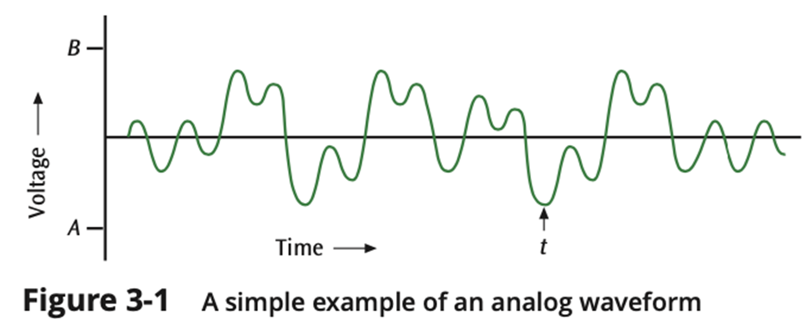
Analog vs. Digital (2 of 7)

Slide 8
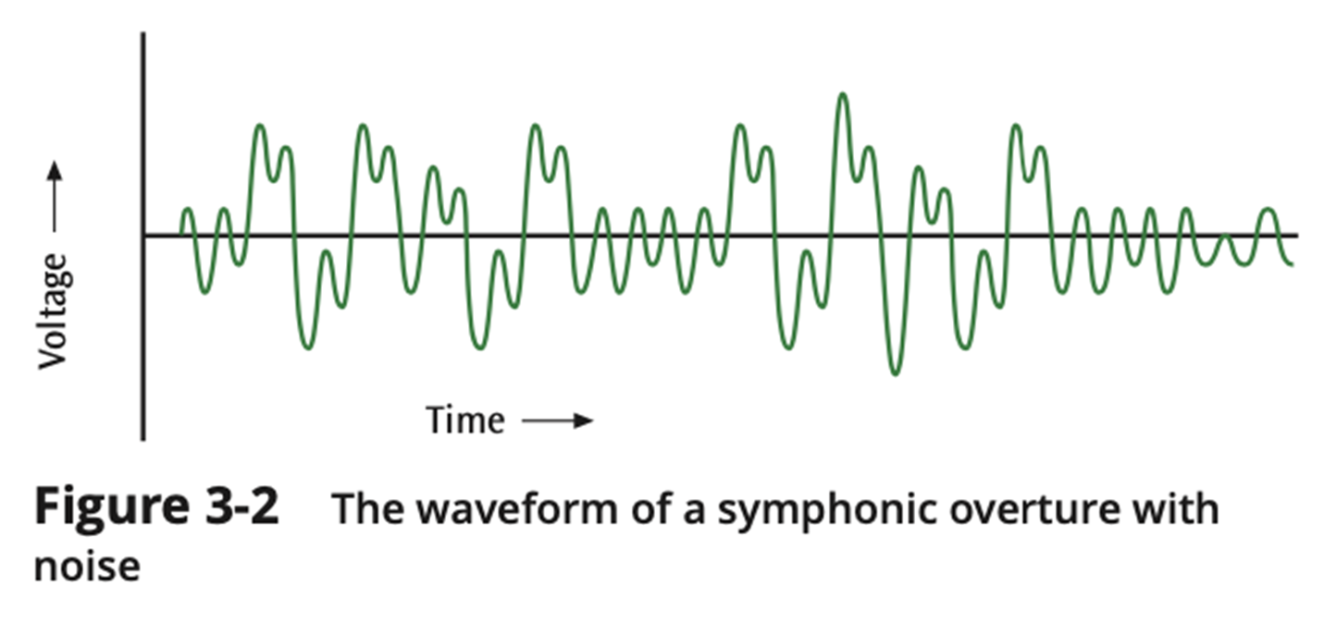
Analog vs. Digital (3 of 7)

Slide 9
Analog vs. Digital (4 of 7)
Digital is a discrete or non-continuous waveform
Something about the signal makes it obvious that the signal can only appear in a fixed number of forms (see next slide)
Noise in digital signal
You can still discern a high voltage from a low voltage
Too much noise – you cannot discern a high voltage from a low voltage

Slide 10
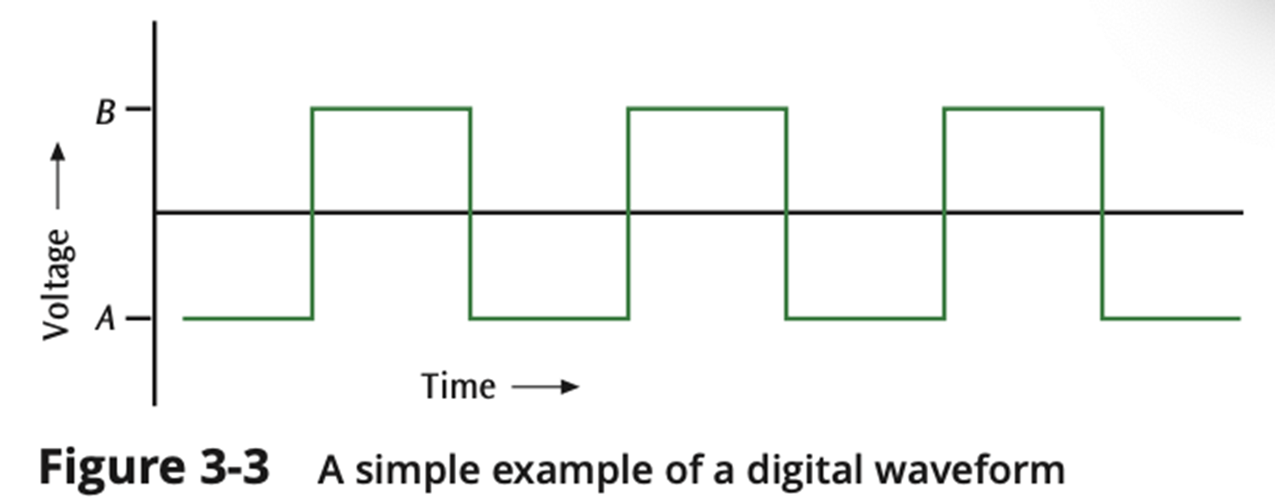
Analog vs. Digital (5 of 7)

Slide 11
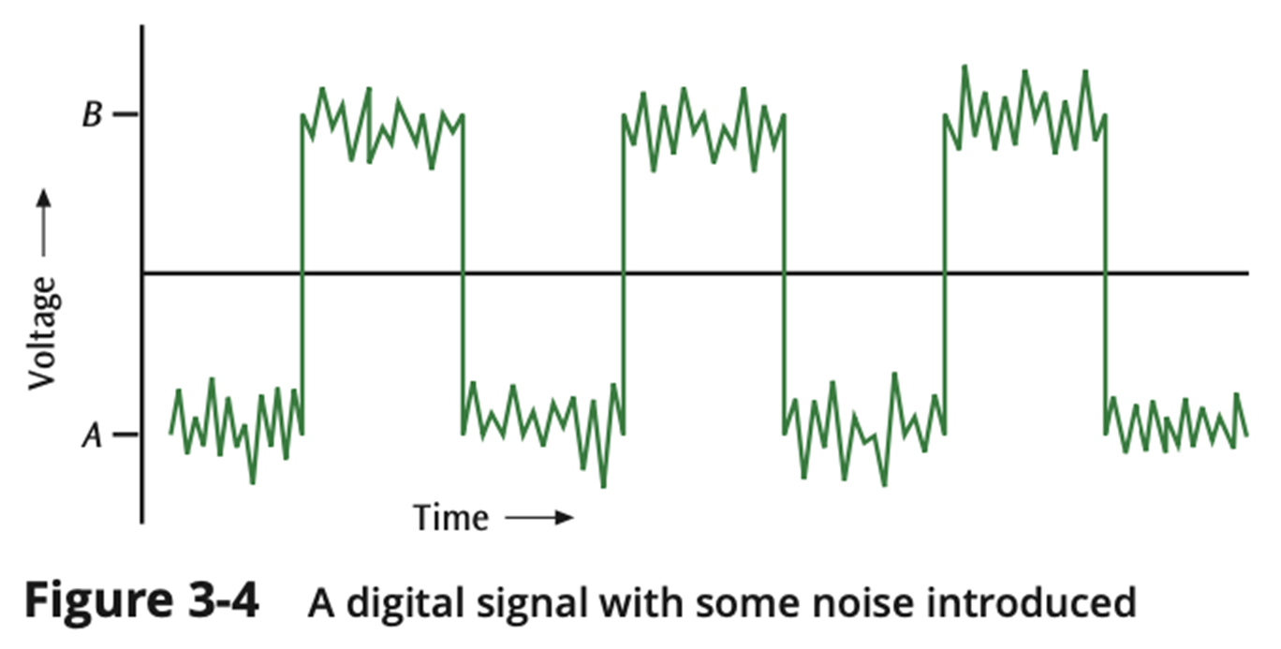
Analog vs. Digital (6 of 7)

Slide 12
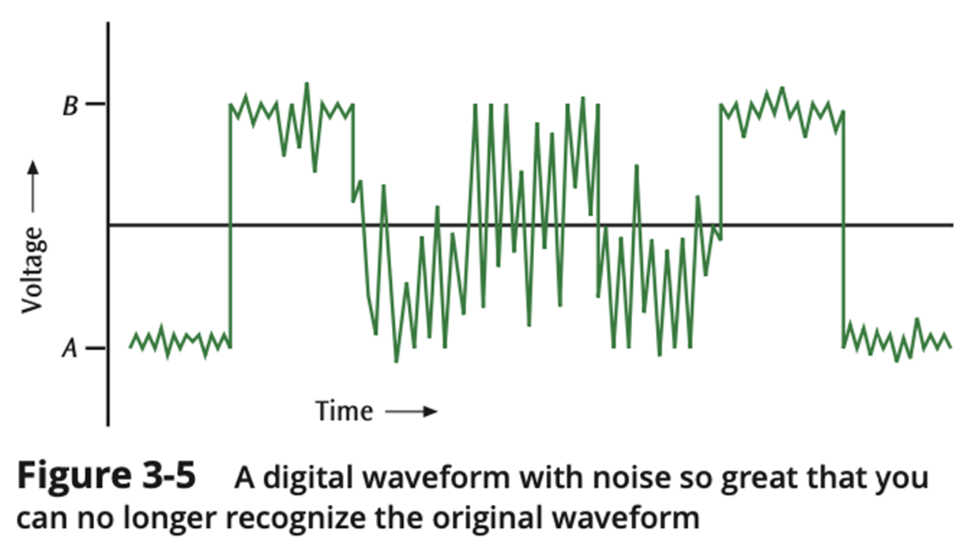
Analog vs. Digital (7 of 7)

Slide 13
Fundamentals of Signals
All signals have three components:
Amplitude
Frequency
Phase

Slide 14
Fundamentals of Signals – Amplitude (1 of 2)
Amplitude
The height of the wave above or below a given reference point
Amplitude is usually measured in volts

Slide 15
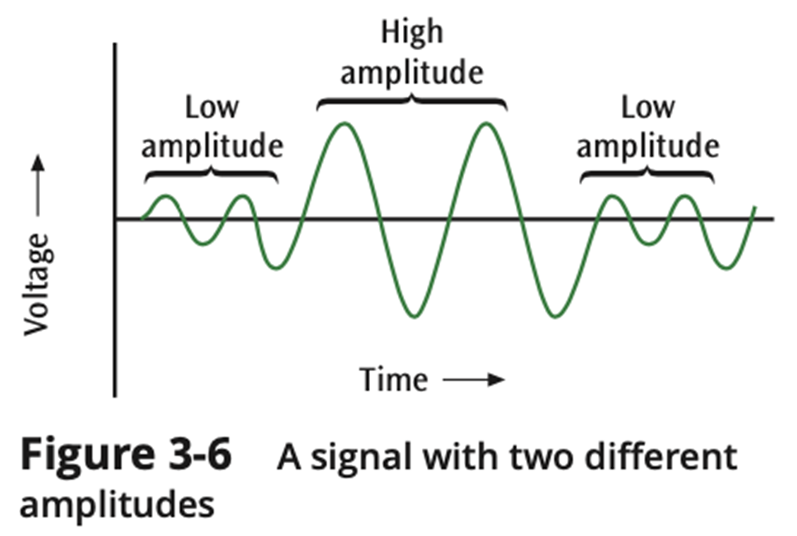
Fundamentals of Signals – Amplitude (2 of 2)

Slide 16
Fundamentals of Signals – Frequency (1 of 2)
Frequency
The number of times a signal makes a complete cycle within a given time frame; frequency is measured in Hertz (Hz), or cycles per second (period = 1 / frequency)
Spectrum – Range of frequencies that a signal spans from minimum to maximum
Bandwidth – Absolute value of the difference between the lowest and highest frequencies of a signal
For example, consider an average voice
The average voice has a frequency range of roughly 300 Hz to 3100 Hz
The spectrum would be 300 – 3100 Hz
The bandwidth would be 2800 Hz

Slide 17
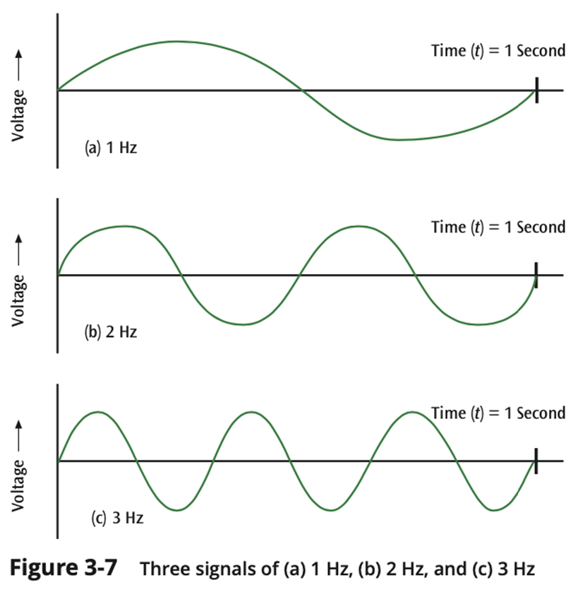
Fundamentals of Signals – Frequency (2 of 2)

Slide 18
Fundamentals of Signals – Phase (1 of 2)
Phase
The position of the waveform relative to a given moment of time or relative to time zero
A change in phase can be any number of angles between 0 and 360 degrees
Phase changes often occur on common angles, such as 45, 90, 135, etc.

Slide 19
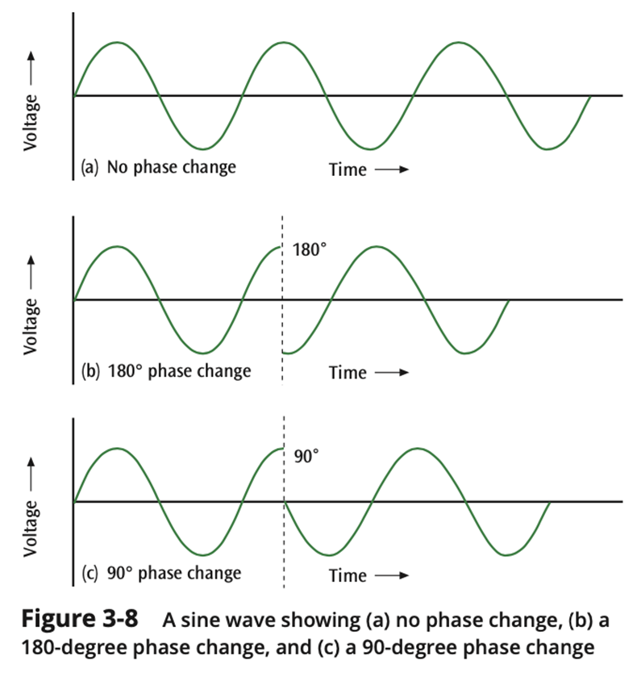
Fundamentals of Signals – Phase (2 of 2)

Slide 20
Fundamentals of Signals - Phase (2 of 2)
Phase
If a signal can experience two different phase angles, then 1 bit can be transmitted with each signal change (each baud)
If a signal can experience four different phase angles, then 2 bits can be transmitted with each signal change (each baud)
Note: number of bits transmitted with each signal change = log2 (number of different phase angles)
(You can replace “phase angles” with “amplitude levels” or “frequency levels”)

Slide 21
Loss of Signal Strength (1 of 4)
All signals experience loss (attenuation)
Attenuation is denoted as a decibel (dB) loss
Decibel losses (and gains) are additive

Slide 22
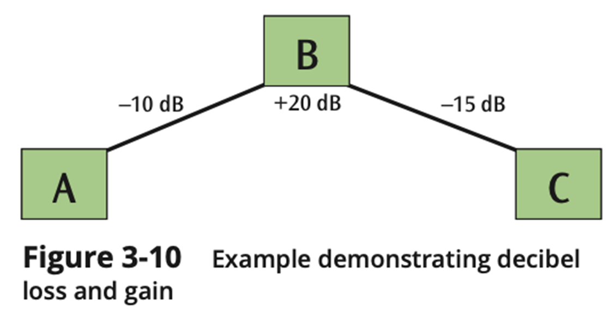
Loss of Signal Strength (2 of 4)

Slide 23
Loss of Signal Strength (3 of 4)
Formula for decibel (dB):
dB = 10 × log10 (P₂ / P₁)
where P₁ is the beginning power level and P₂ is the ending power level

Slide 24
Loss of Signal Strength (4 of 4)
So, if a signal loses 3 dB, is that a lot?
What if a signal starts at 100 watts and ends at 50 watts? What is dB loss?
dB = 10 × log₁₀ (P₂ / P₁)
dB = 10 × log₁₀ (50 / 100)
dB = 10 × log₁₀ (0.5)
dB = 10 × −0.3
dB = −3.0
So, a 3.0 decibel loss corresponds to lose half of signal power

Slide 25
Converting Data into Signals
There are four main combinations of data and signals:
Analog data transmitted using analog signals
Digital data transmitted using digital signals
Digital data transmitted using discrete analog signals
Analog data transmitted using digital signals
Let’s look at each of these

Slide 26
Transmitting Analog Data with Analog Signals (1 of 2)
In order to transmit analog data, you can modulate the data onto a set of analog signals
Broadcast radio and the older broadcast television are two very common examples of this
We modulate the data onto another set of frequencies so that all the different channels can coexist at different frequencies

Slide 27
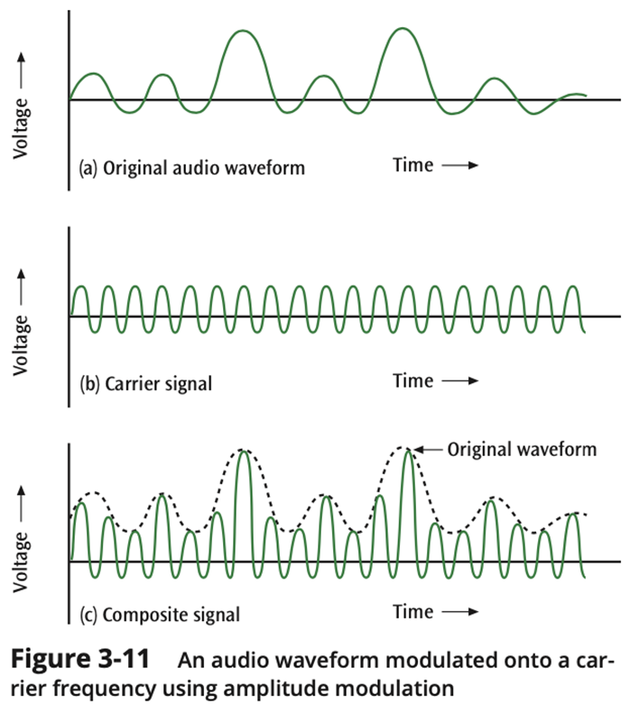
Transmitting Analog Data with Analog Signals (2 of 2)

Slide 28
Transmitting Digital Data with Digital Signals: Digital Encoding Schemes
There are numerous techniques available to convert digital data into digital signals. Let’s examine five:
NRZ-L
NRZI
Manchester
Differential Manchester
4B/5B

Slide 29
Nonreturn to Zero Digital Encoding Schemes (1 of 2)
Nonreturn to zero-level (NRZ-L) transmits 1s as zero voltages and 0s as positive voltages
Nonreturn to zero inverted (NRZI) has a voltage change at the beginning of a 1 and no voltage change at the beginning of a 0
Fundamental difference exists between NRZ-L and NRZI
With NRZ-L, the receiver has to check the voltage level for each bit to determine whether the bit is a 0 or a 1,
With NRZI, the receiver has to check whether there is a change at the beginning of the bit to determine if it is a 0 or a 1

Slide 30
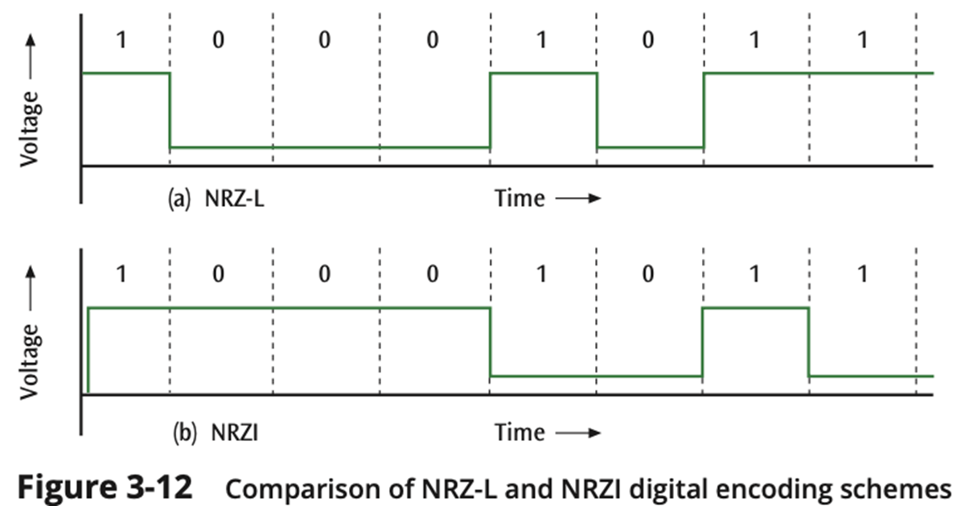
Nonreturn to Zero Digital Encoding Schemes (2 of 2)

Slide 31
Manchester Digital Encoding Schemes (1 of 2)
In Manchester code encoding scheme:
to transmit a 1, the signal changes from low to high in the middle of the interval, and
to transmit a 0, the signal changes from high to low in the middle of the interval
In Differential Manchester code, every bit has at least one significant change, some bits have two signal changes per bit (baud rate = twice bps)

Slide 32
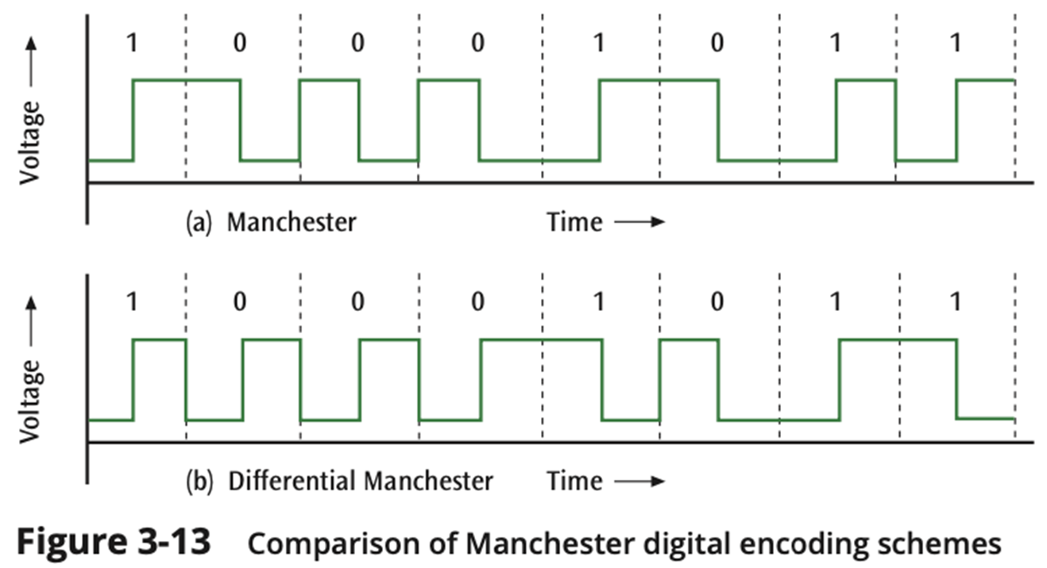
Manchester Digital Encoding Schemes (2 of 2)

Slide 33
4B/5B Digital Encoding Scheme (1 of 2)
The 4B/5B scheme tries to satisfy the synchronization problem and avoid the “baud equals two times the bps” problem
It converts four bits of data into five-bit quantities
The five-bit quantities are unique in that no five-bit code has more than 2 consecutive zeros
The five-bit code is then transmitted using an NRZI encoded signal

Slide 34
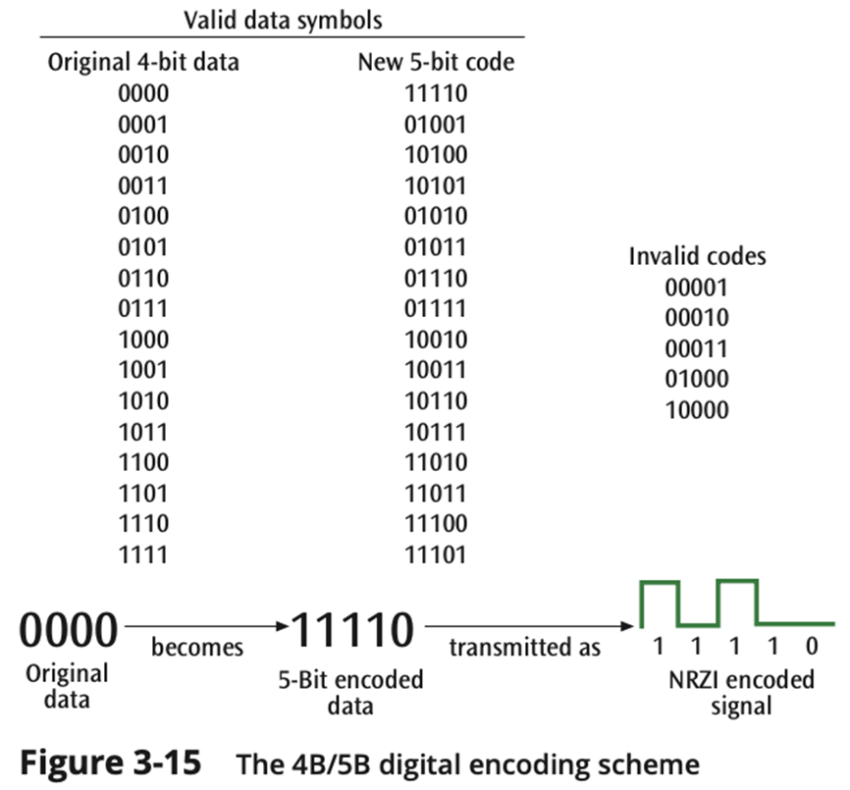
4B/5B Digital Encoding Scheme (2 of 2)

Slide 35
Transmitting Digital Data with Discrete Analog Signals
Three basic techniques:
Amplitude shift keying
Frequency shift keying
Phase shift keying
One can then combine two or more of these basic techniques to form more complex modulation techniques (such as quadrature amplitude modulation)

Slide 36
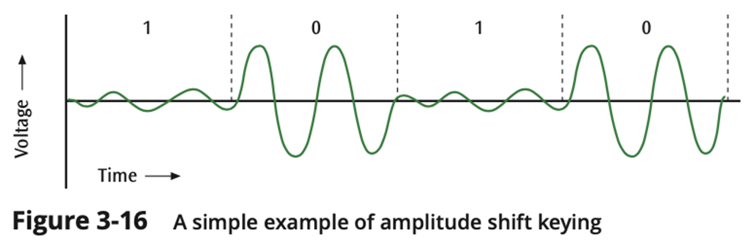
ASK - Amplitude Shift Keying (1 of 2)
One amplitude encodes a 0 while another amplitude encodes a 1 (a form of amplitude modulation)

Slide 37
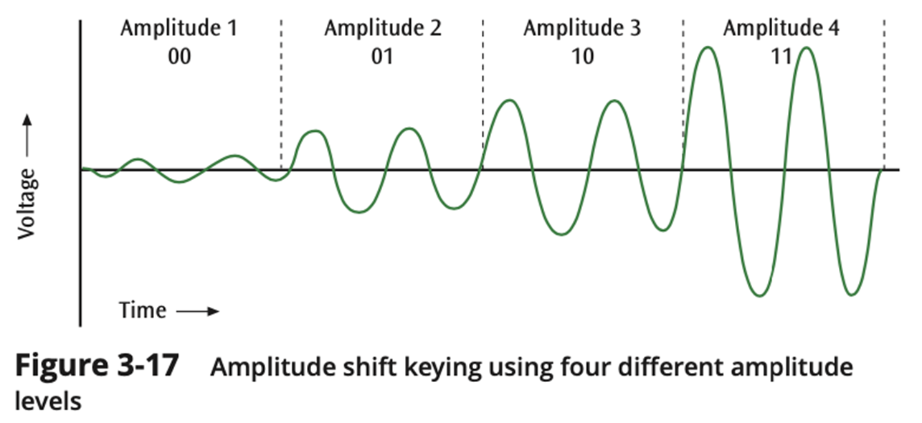
ASK - Amplitude Shift Keying (2 of 2)
Note: here we have four different amplitudes, so we can encode 2 bits
in each signal change (bits per signal change = log₂ (amplitude levels)).

Slide 38
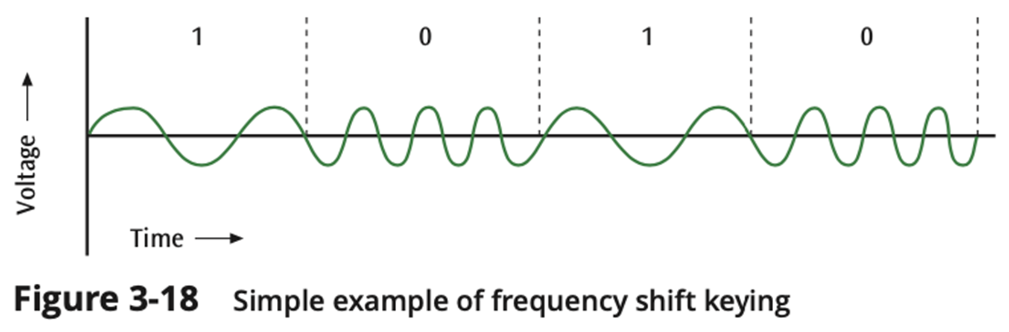
FSK - Frequency Shift Keying
One frequency encodes a 0 while another frequency encodes a 1 (a form of frequency modulation)

Slide 39
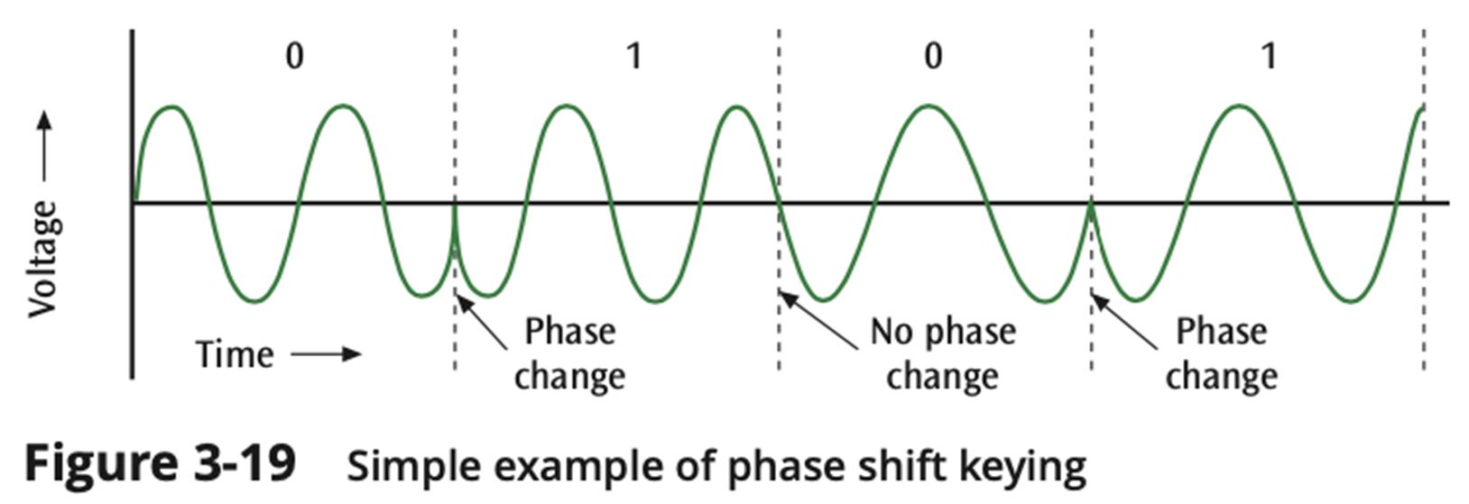
PSK - Phase Shift Keying (1 of 5)
One phase change encodes a 0 while another phase change encodes a 1 (a form of phase modulation)

Slide 40
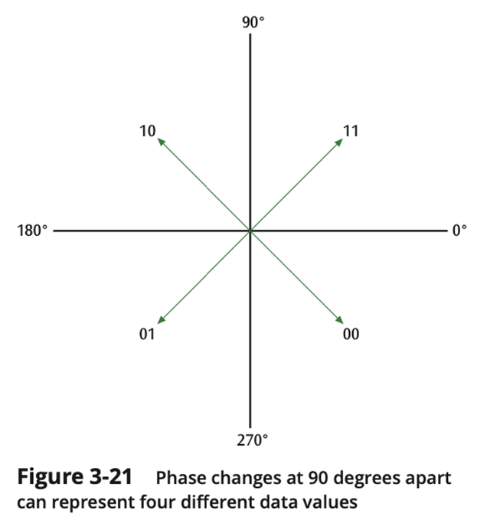
PSK - Phase Shift Keying (2 of 5)
Quadrature Phase Shift Keying
Four different phase angles used
45 degrees
135 degrees
225 degrees
315 degrees

Slide 41
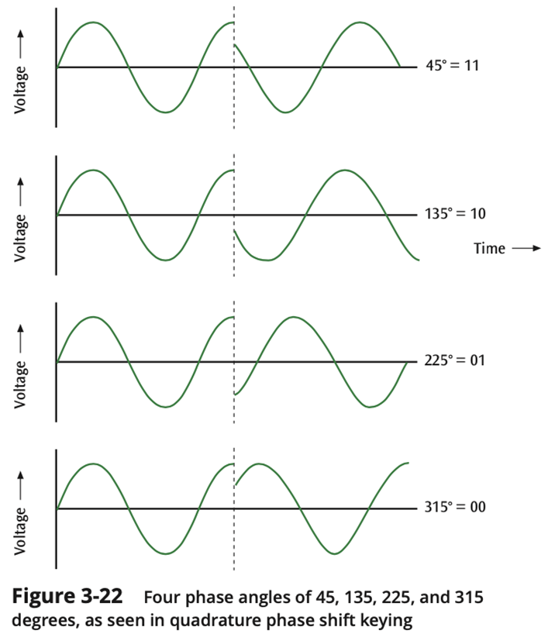
PSK - Phase Shift Keying (3 of 5)

Slide 42
PSK - Phase Shift Keying (4 of 5)
QAM - Quadrature amplitude modulation
As an example of QAM, 12 different phases are combined with two different amplitudes
Since only 4 phase angles have 2 different amplitudes, there are a total of 16 combinations
With 16 signal combinations, each baud equals 4 bits of information (log2(16) = 4, or inversely, 2 ^ 4 = 16)

Slide 43
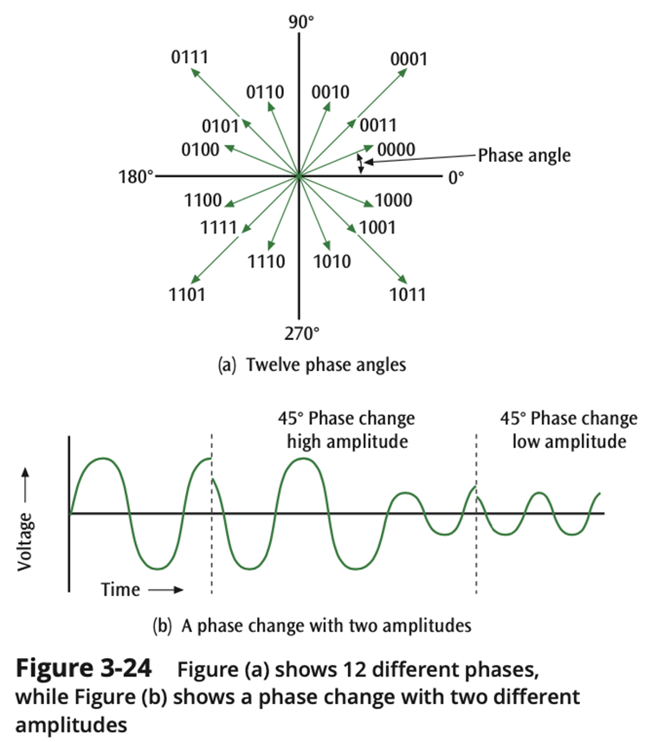
PSK - Phase Shift Keying (5 of 5)
QAM
Quadrature amplitude modulation

Slide 44
Transmitting Analog Data with Digital Signals
To convert analog data into a digital signal, there are two techniques:
PCM - Pulse code modulation (the more common)
Delta modulation

Slide 45
PCM - Pulse Code Modulation (1 of 8)
The analog waveform is sampled at specific intervals and the “snapshots” are converted to binary values
“Codec" hardware converts analog data into a digital signal
Tracking an analog waveform and converting it to pulses that represent the wave’s height above or below a threshold
PAM (pulse amplitude modulation)

Slide 46
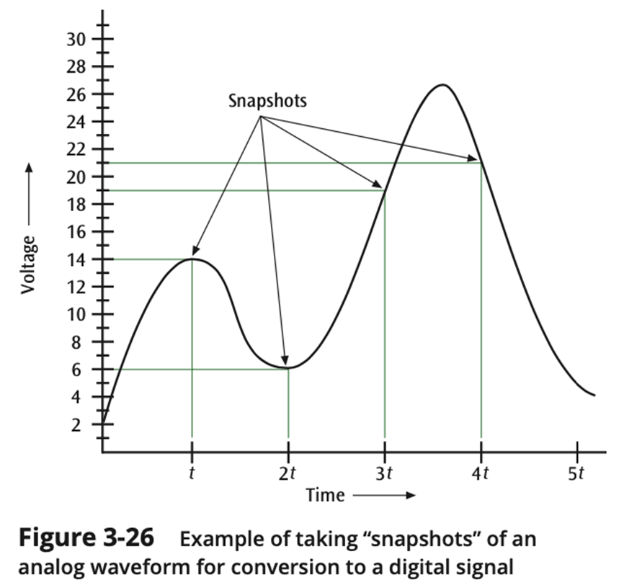
PCM - Pulse Code Modulation (2 of 8)

Slide 47
PCM - Pulse Code Modulation (3 of 8)
After transmitting the digital signals (binary values), those are later converted back to an analog signal, in a way that a waveform similar to the original one is produced
This reconstruction is based on digital "snapshots" (samples) and quantization levels
The differences between the original and reconstructed waveform are called
Quantizing error

Slide 48
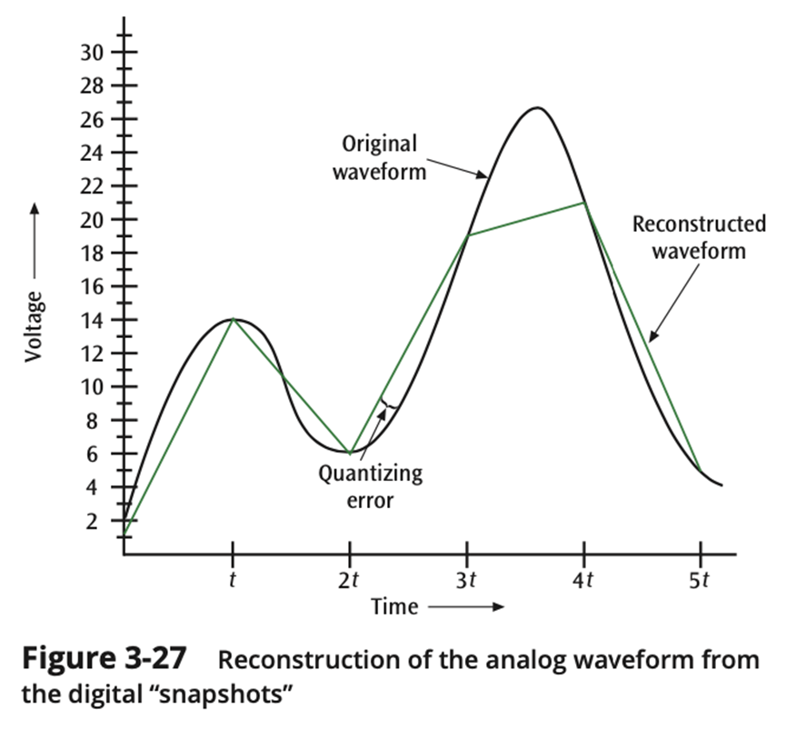
PCM - Pulse Code Modulation (4 of 8)

Slide 49
PCM - Pulse Code Modulation (5 of 8)
To reduce the quantizing error it is possible to:
Take more snapshots in the same amount of time (more frequent samples), or
Increase the quantization levels
It results in a better resolution for the reconstructed waveform, thus less quantizing error

Slide 50
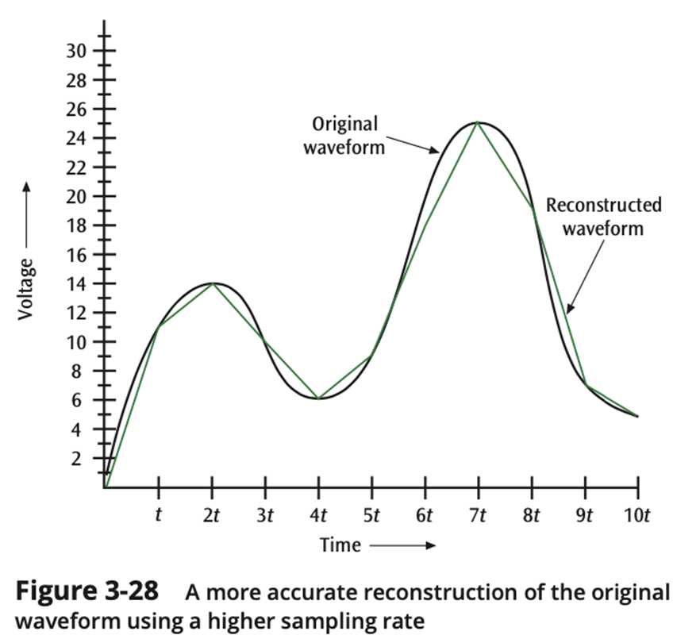
PCM - Pulse Code Modulation (6 of 8)

Slide 51
PCM - Pulse Code Modulation (7 of 8)
For example, digital telephone systems digitize human voice, and since the human voice has a fairly narrow bandwidth (3400 Hz), telephone systems can digitize voice (assuming a 4000 Hz range) into either 128 or 256 quantization levels:
If 128 levels, then each sample is 7 bits (2⁷ = 128)
If 256 levels, then each sample is 8 bits (2⁸ = 256)
For wider ranges than human voice, a higher number of quantization levels may be needed

Slide 52
PCM - Pulse Code Modulation (8 of 8)
Besides increasing the number of quantization levels, it is possible to increase the number of samples ("snapshots")
How fast do you have to sample an input source to get a fairly accurate representation?
According to Nyquist's communication theorem:
you need two times the highest frequency
Thus, if you want to digitize voice (4000 Hz), you need to sample at 8000 samples per second

Slide 53
Delta Modulation (1 of 2)
The "codec" tracks the incoming analog data by assessing up or down “steps”
The analog waveform is tracked, using a binary 1 to represent a rise in voltage, and a 0 to represent a drop in voltage
Each analog value is first converted to a PAM value, and then converted to binary
Only 1 bit per sample is generated, thus, delta modulation is quicker than with PCM

Slide 54
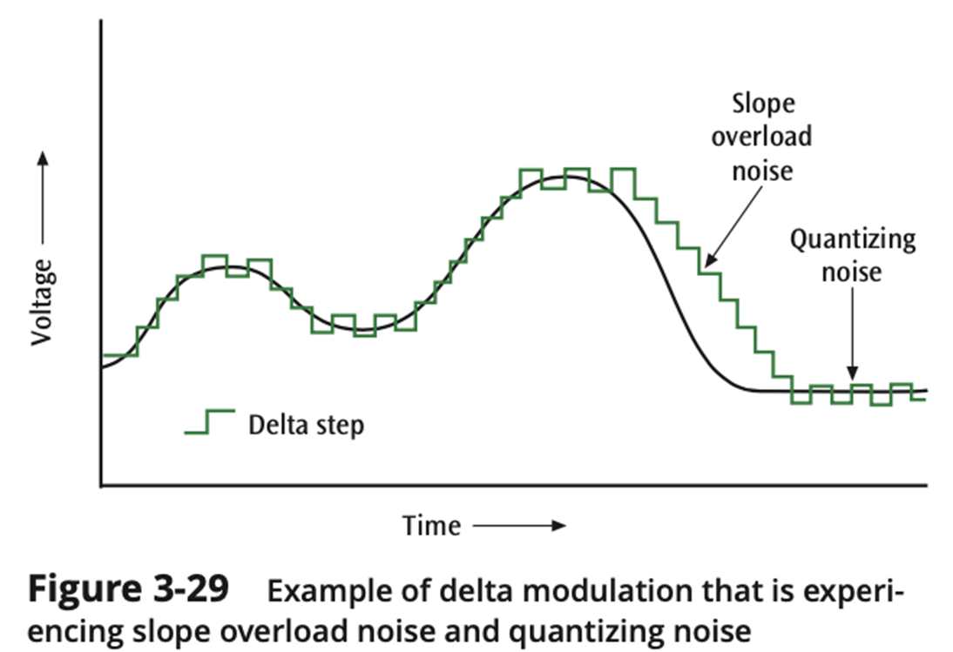
Delta Modulation (2 of 2)

Slide 55
The Relationship Between Frequency and Bits Per Second (1 of 2)
Higher Data Transfer Rates
How do you send data faster?
Use a higher frequency signal (make sure the medium can handle the higher frequency
Use a higher number of signal levels
In both cases, noise can be a problem

Slide 56
The Relationship Between Frequency and Bits Per Second (2 of 2)
Maximum Data Transfer Rates
How do you calculate a maximum data rate?
Use Shannon’s equation
S(f) = f × log₂ (1 + S/N)
Where f = signal frequency (bandwidth), S is the signal power in watts, and N is the noise power in watts
For example, what is the data rate of a 3400 Hz signal with 0.2 watts of power and 0.0002 watts of noise?
S(f) = 3400 × log₂ (1 + 0.2/0.0002)
= 3400 × log₂ (1001)
= 3400 × 9.97
= 33898 bps

Slide 57
Characters and Codes
The set of all textual characters or symbols and their corresponding binary patterns is called a data code
The common data encoding schemes are:
ASCII - American Standard Code for Information Interchange
Simple 7-bit based - 128 possible values
Unicode - Universal Code
To include virtually all characters in every language

Slide 58
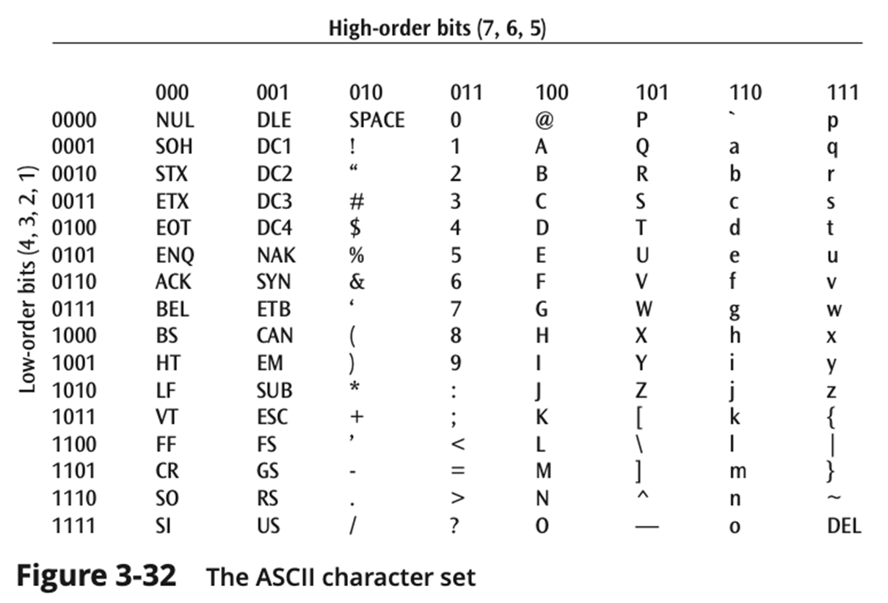
ASCII (1 of 2)

Slide 59
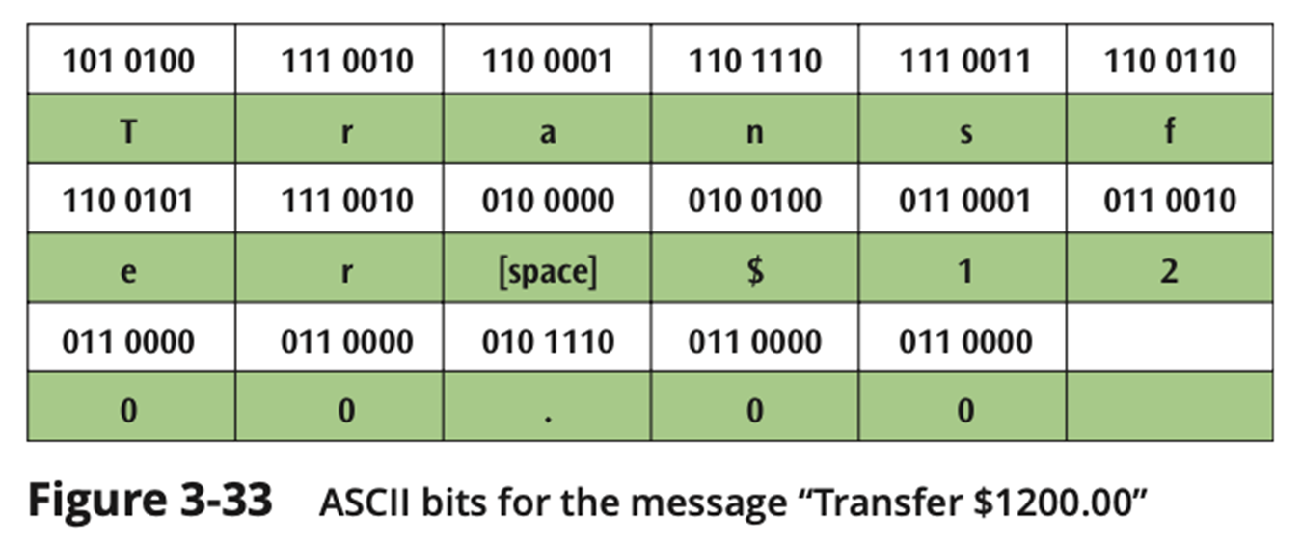
ASCII (2 of 2)

Slide 60
Unicode (1 of 2)
Currently supports 145,000 unique characters
A large number of languages / character sets
Two currently available versions:
UTF-8 - dedicates 1 to 4 8 bytes (8 bits) to encode each symbol
now far more popular than UTF-16, an even ASCII
UTF-16 - dedicates 2 to 4 bytes to encode each symbol
Unicode is more robust than ASCII as it delivers character encoding no matter the platform

Slide 61
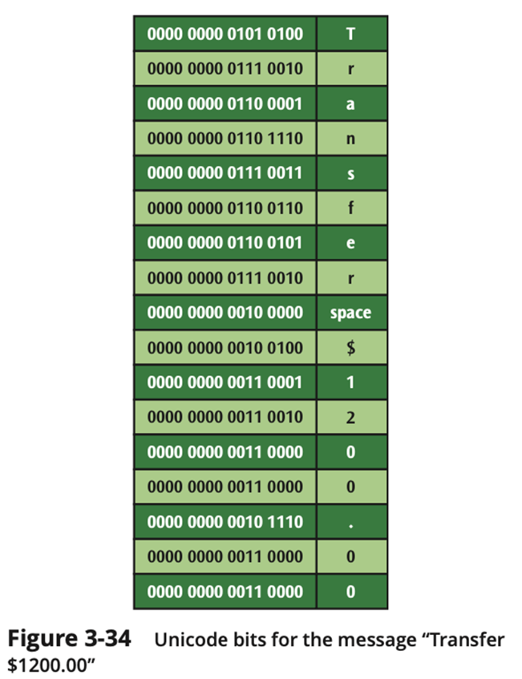
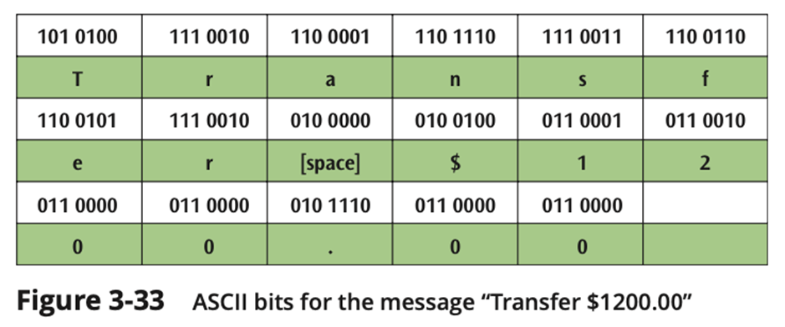
Unicode (2 of 2)
UTF-8
ASCII

Slide 62
Summary (1 of 3)
Data and signals are two basic building blocks of computer networks
All data transmitted is either digital or analog
Data is transmitted with a signal that can be either digital or analog
All signals consist of three basic components: amplitude, frequency, and phase
Two important factors affecting the transfer of a signal over a medium are noise and attenuation
Four basic combinations of data and signals are possible: analog data converted to an analog signal, digital data converted to a digital signal, digital data converted to a discrete analog signal, and analog data converted to a digital signal

Slide 63
Summary (2 of 3)
To transmit analog data over an analog signal, the analog waveform of the data is combined with another analog waveform in a process known as modulation
Digital data carried by digital signals is represented by digital encoding formats
For digital data to be transmitted using analog signals, digital data must first undergo a process called shift keying or modulation
Three basic techniques of shift keying are amplitude shift keying, frequency shift keying, and phase shift keying

Slide 64
Summary (3 of 3)
Two common techniques for converting analog data so that it may be carried over digital signals are pulse code modulation and delta modulation
Data codes are necessary to transmit the letters, numbers, symbols, and control characters found in text data
Currently used data codes are ASCII and Unicode

